Slide 1
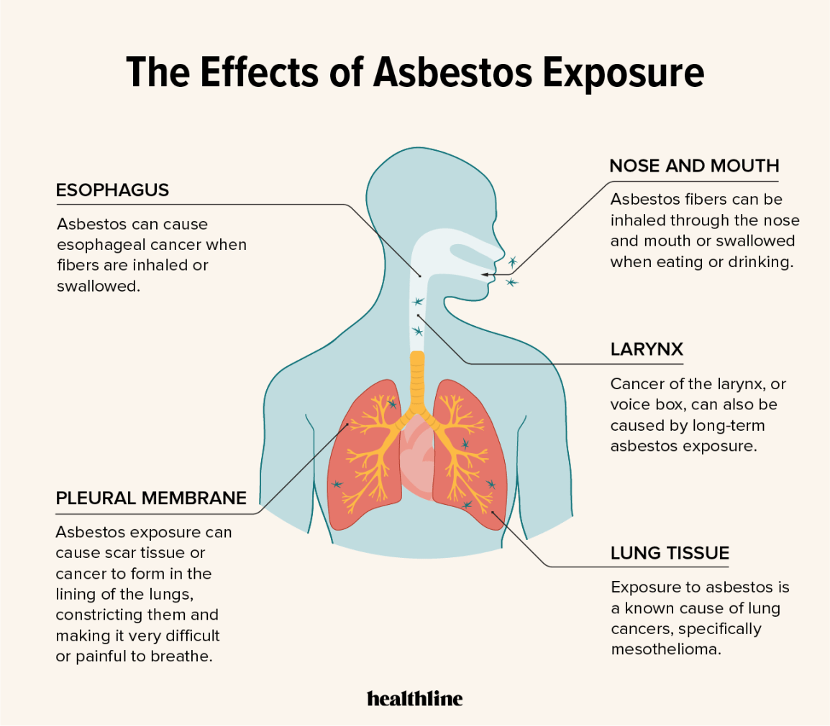
Linear Regression Analysis for Effect of Asbestos exposure (1984-1990) on pulmonary function testing
Presented by : Ravikumar Panchal

Slide 2
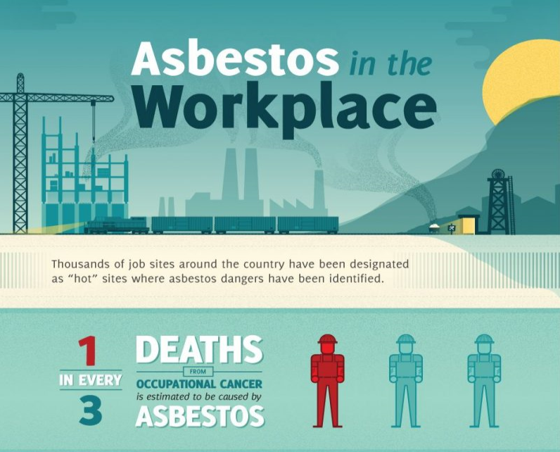
Outline
Introduction
Background
Study Design and Analysis
Results
Discussion
Conclusion
References

Slide 3
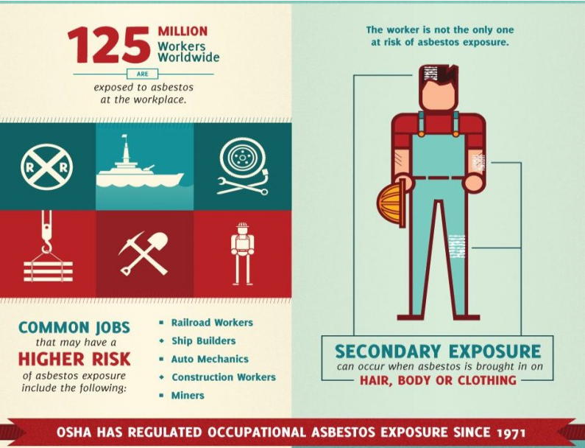
introduction
Asbestos - construction of naval vessels, including ships, submarines, and shore facilities, for much of the 20th century.
Asbestos fibers -airborne when materials containing asbestos are damaged or deteriorate, and inhaling these microscopic fibers can lead to health problems, particularly respiratory conditions and various forms of cancer, including mesothelioma.
The U.S. Navy -1970s, and the use of asbestos-containing materials in naval construction significantly decreased in subsequent years.
The U.S. Navy developed an asbestos abatement program in the late 1970s in response to increasing concerns about the adverse effects of asbestos exposure in the military and civilian workforce.
That program included improved asbestos abatement processes and lower asbestos exposure levels in the workplace. As a result the number of exposed workers has also decreased.

Slide 4
Introduction (Continue…)
This study examined records from the Navy Asbestos Medical Surveillance Program for 1984 through 1990 for Caucasian men (N =129,598) using a linear regression model.
Continuous dependent variables :
Forced expiratory volume in 1 s and
Forced vital capacity (FVC)
Continuous independent variables :
Age,
Height,
Weight,
Tobacco use

Slide 5
Introduction (Continue…)
With asbestos exposure, forced expiratory volume in 1 s changed -3.2 cm3 /year (t =- 8.6, p =0.000), and forced vital capacity changed -5.1 cm3/year (t =-11.8, p=0.000).
These findings support the association of pulmonary function impairment with asbestos exposure for workers studied during this period.

Slide 6
Background
The Asbestos Medical Surveillance Program (AMSP) was implemented, which included periodic examinations at local military medical treatment facilities for exposed personnel.
Information from those examinations was forwarded to the Navy Environmental Health Center (NAVENVIRHLTHCEN) where it was maintained in a data repository for future analysis.
450,000 records entered in the database since 1980
Approximately 300,000 between 1980 and 1990.
Approximately 150,000 between 1991 and 1999.
Authors from NAVENVIRHLTHCEN have published several articles from information in the database.
Several other authors have published information from localized subsets of the asbestos-exposed population.

Slide 7
Background (Continue…)
Three basic reporting forms were used, with the initial NAVMED 6260/5 used from 1980 to 1983.
Although recording of most of the variables was unchanged, measurement of asbestos exposure changed from a categorical variable to a continuous variable. The earlier data presented asbestos exposure in categories of
none,
1 year,
1 to 5 years,
5 to 15 years, and
more than 15 years exposure.
Reporting after 1991 provided information on the beginning and ending ages for asbestos exposure, which allowed calculation for the number of years of asbestos exposure. Thus, the information on the three forms was complementary, but not completely equivalent, which lead to separating the periods.

Slide 8
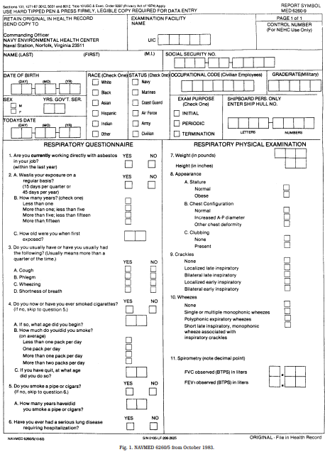
Figure -1

Slide 9
Study Design and Analysis
(FEV1) and (FVC) in cubic centimeters were obtained from the database, as were height in inches and weight in pounds.
The FEV1 and FVC values were measured with standard protocols detailed from the NAVENVIRONHLTHCEN.2
Incomplete records or apparent data transcription errors to illogical results, a number of records were excluded.
Smoking history less than 0 or greater than 51 years.
Height less than 50 inches or more than 79 inches,
Weight less than 100 lbs or more than 320 lbs.
Age of less than 30 years or more than 60 years.
Younger personnel had minimal asbestos exposure and older personnel would have been eligible for retirement

Slide 10
Study Design and Analysis (Continue..)
Because of the categorical groupings for asbestos exposure,initially analyze the data in a linear regression model using a mid-period approximation
0 years for categories of 0–1 years exposure,
3 years for 1–5 years exposure
10 years for 5–15 years exposure, and
20 years for greater than 15 years exposure.
Choose to analyze the data with cut points for the duration of asbestos exposure. The initial cut point was less than 1 year of exposure compared with 1 to 5 years of exposure.
The second analysis was less than 5 years exposure compared with 5 to 15 years of exposure.
The third analysis was for less than 15 years exposure compared with more than 15 years of exposure

Slide 11
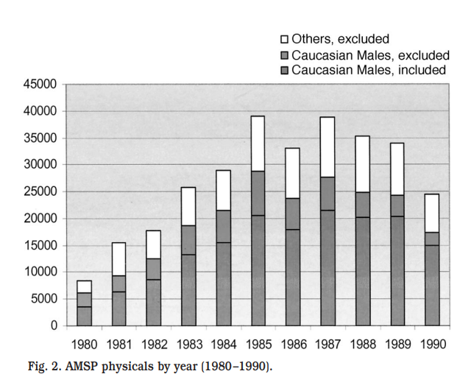
results
Figure 2- The number of physicals reported
The number of examinations submitted per year increased over the early part of the study and began decreasing in approximately 1987.
Caucasian men excluded because of omitted information, and all others.

Slide 12
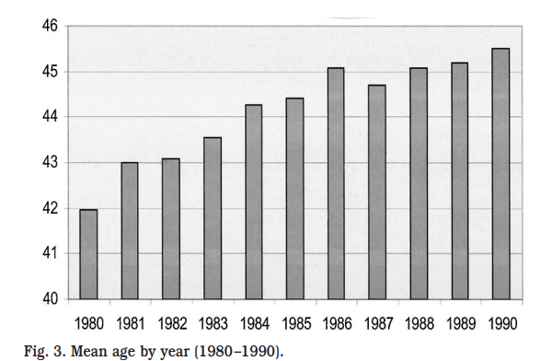
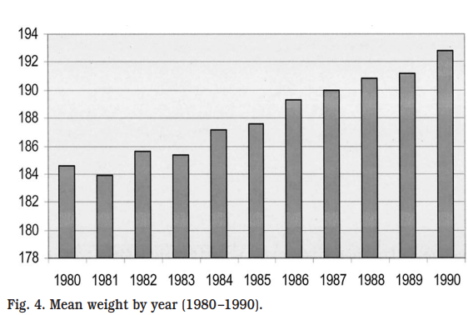
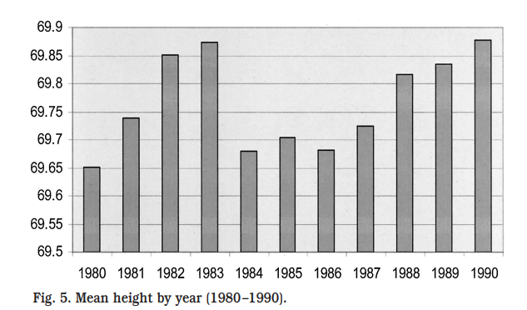
Results (Continue…)
Figure 3 displays the mean age for the personnel included in the study, which increased over the duration of the study
Age in years =0.257 * [year of examination after 1980] + 43, t =31, p =0.000.
Figure 4 presents mean weight in pounds by year and demonstrates a significant increase over the period.
Weight = 0.92 *[year of examination after 1980] +183 lbs, t =30, p =0.000).
Figure 5 displays the mean height in inches by year and suggests no overall trend in the population.
Height = 0.04 * [year of examination after 1980] +69.7 inches, t = 1.49, p = 0.136).

Slide 13
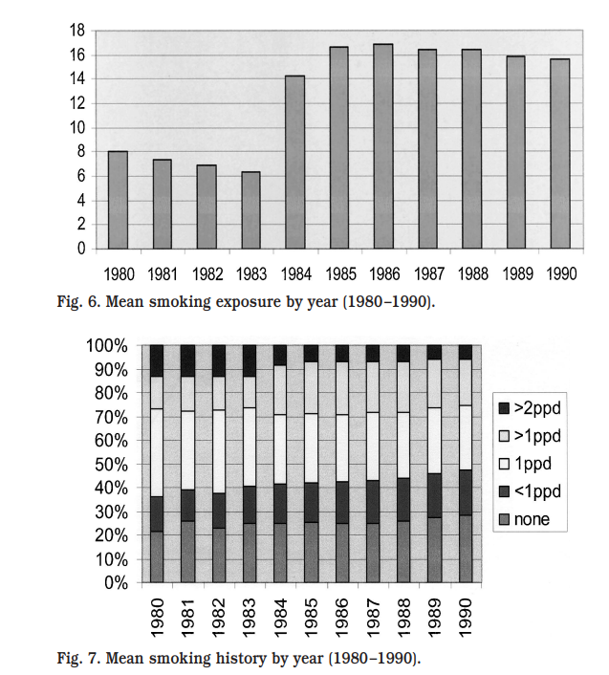
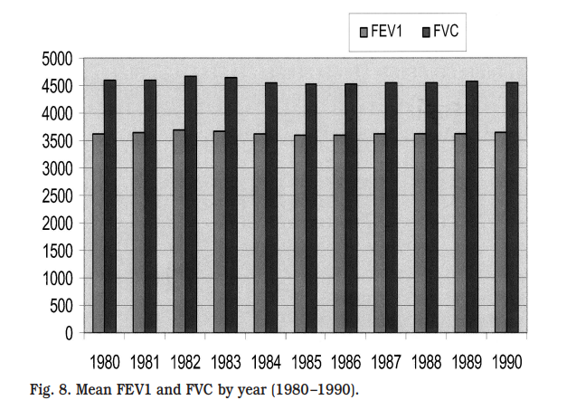
Results (Continue…)
Figure 6 presents the mean duration for smoking for personnel in the study, which has a perplexing finding.
The duration of smoking peaked in 1985 and decreased there after .
Smoking in years =-0.224 * [year of examination after 1984] +18, t =-9.4, p = 0.000).
Figure 7 displays the smoking categories for the period, and suggests a trend of decreasing smoking through the period.
Figure 8 displays mean FEV1 and FVC for the population, noting the mean FEV1 was approximately 3,500 mL throughout the period
FEV1 =-1.375 *[year of the examination after 1980] + 3,634 mL, t = 1.84, p = 0.065).
Mean FVC decreased throughout the period .
FVC =-6.7 *[year of examination after 1980] + 4,600 mL, t = 7.88, p = 0.000).

Slide 14
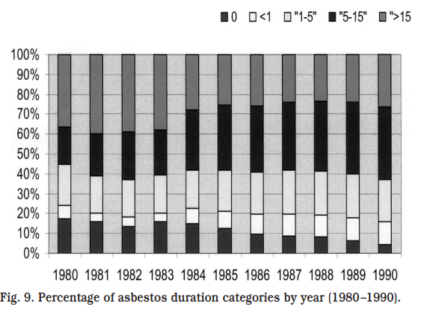
Results (Continue…)
However, for records after 1983, FEV1 and FVC increased.
FEV1 =3,571 mL + 6.725 *[years after 1980], t = -5.973, p =0.000;
FVC =4,499 +6.155 * [years after 1980], t = -4.789, p = 0.000).
Figure 9 displays asbestos exposure length categories by year of the study, and suggests generally consistent reporting from 1980 through 1990.

Slide 15
Discussion
The population with asbestos exposure >5 years, reduction in pulmonary functions whereas exposure of 1 to 5 years ,did not produce significant impairment. Exposure of more than 15 years, greater impairment.
Smoking demonstrated generally consistent and statistically significant impairment in pulmonary function.
Tobacco use appeared to begin decreasing in the mid 1980s, which is a positive finding, although how much of that decrease is derived from any effects of counseling from AMSP is unclear.
One year of smoking had approximately three to four times the adverse effect on FEV1 as compared with 1 year of asbestos exposure and one and one-half to two times the adverse effect on FVC.
Interaction between asbestos exposure and smoking was only observed for those with 5 to 15 years of exposure compared with those with less exposure, and then were just below the significance level of p = 0.05.
This supports ongoing efforts for reducing tobacco smoking as part of the AMSP

Slide 16
Conclusion
A statistically significant reduction in pulmonary function testing with asbestos exposure for those with more than 5 years of exposure in male Caucasian personnel in the Navy AMSP for 1984 through 1990.
Personnel -1 and 5 years of exposure-no impairment compared with those with 0 to 1 years of exposure.
Exposure of more than 15 years demonstrated additional pulmonary impairment.
Smoking demonstrated a statistically significant impairment in pulmonary function in the studied population and supports continued efforts to reduce smoking in the population.

Slide 17

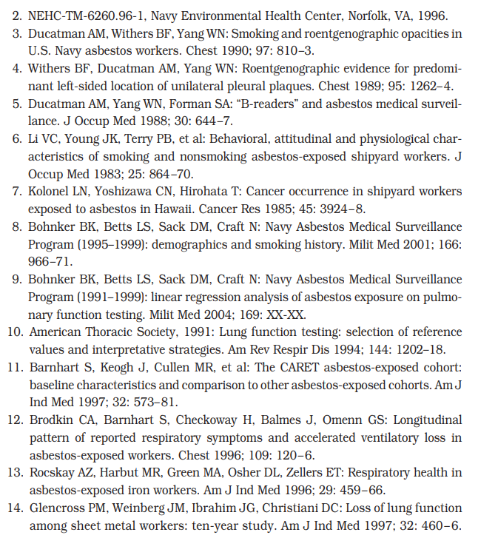
reference

